Slide 1
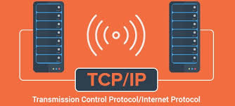
TCP/IP Model
Presented by:
Manoj Dahal
Nabin Chaulagain
Nakul Oli
Nabin Rawat
Nista Chauhan

Slide 2
Contents:
Introduction to TCP/IP
Why TCP/IP?
TCP/IP Diagram
Layers of TCP/IP model
1)Application layer
2) Transport Layer
3) Internet Layer
4)Network Layer
Merits of TCP/IP
Demerits of TCP/IP

Slide 3
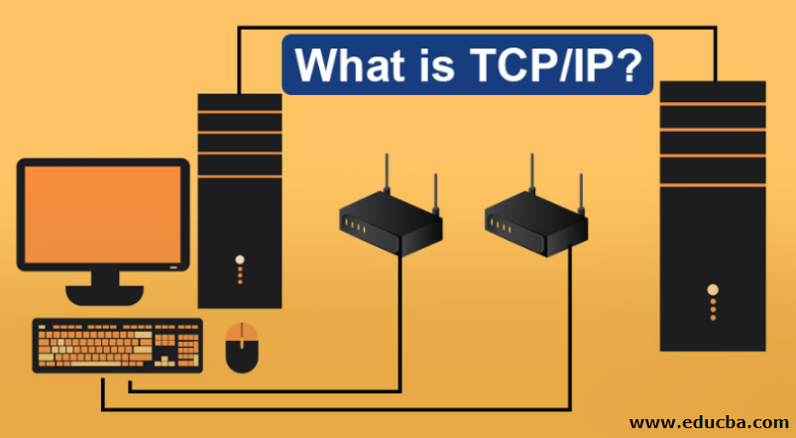

Slide 4
Introduction
TCP/IP (Transmission Control Protocol / Internet Protocol) is the set of communication protocols used for the internet and other similar networks.
TCP/IP was developed by Department of Defense's Project Research Agency (ARPA, later DARPA) as a part of a research project of network interconnection to connect remote machines.
It is named from two of the most important protocols in it:
Transmission Control Protocol: This protocol ensures the delivery of information packets across networks. It is a connection oriented protocol.
Internet Protocols: This most important protocol is responsible for providing logical addressing called IP address to route information between networks.

Slide 5
Why TCP/IP??
TCP/IP is important because whole internet runs over it. Without TCP/IP the data communication and internet or inter-networking of the devices is not possible.
It is the basis for all the networking applications and networking devices you use everyday. From your email to your web browser to the PC that runs those application and connects them to the internet, all of them are based on a core concept of TCP/IP model.
If you know the TCP/IP model from the bottom to the top, no matter what type of devices or overall system you are working wit, you will be able to move through troubleshooting much faster and more efficiently.

Slide 6
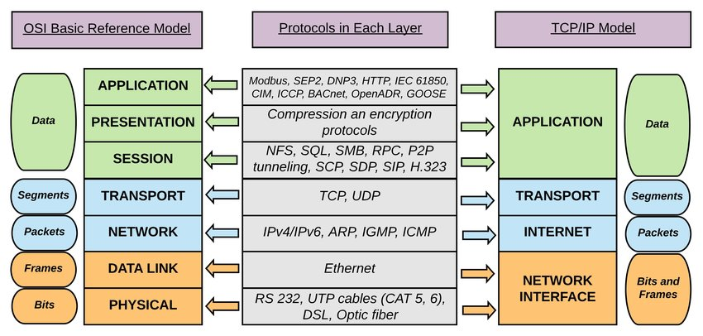
TCP/IP and its protocol Diagram

Slide 7
Application layer
This layer is comparable to the application , presentation and session layers of the OSI model all combined into one.
It provides a way for applications to have access to networked services.
This layer also contains the high level protocols. The main issue with this layer is the ability to use both TCP and UDP protocols.
For example: TFTP uses UDP because usually on LAN the physical links are short enough to ensure quick and reliable packet without any errors. SMTP instead uses TCP because of the error checking capabilities.

Slide 8
The TCP/IP specifications described a lot of applications that were at the top of the protocol stack. Some of them were TELNET, FTP, SMTP, DNS etc.
TELNET is a two- way communication protocol which allows connecting to a remote machine and run applications on it.
FTP is a protocol that allows file transfer amongst computer users connected over a network. It is reliable, simple and efficient.
DNS resolves an IP address into a textual address for hosts connected over a network.
SMTP is used to send emails.
TFTP is a stripped down version of FTP. It is small and fast protocol, but it doesn’t support authentication. Because of this, security risk it is not used widely.
HTTP is foundation of the World Wide Web. It is used to transfer Webpages and such resources from the Web Server or HTTP server to the Web Client or the HTTP client. When you use a web browser such as Internet Explorer or Firefox, you are using a web client. It uses HTTP to transfer web pages that you request from the remote servers.

Slide 9
Transport layer
The transport layer’s primary function is to provide communication from one application program to another.
It uses checksums, acknowledgments, and timeouts to control transmission and end to end verification.
Two protocols available in this layer are Transmission Control Protocol (TCP) and User Datagram Protocol (UDP). TCP is a connection-oriented and reliable protocol that uses windowing to control the flow and provides ordered delivery of the data in segments. On the other hand, UDP simply transfers the data without the bells and whistles. Though these two protocols are different in many ways, they perform the same function of transferring data and they use a concept called port numbers to do this.
It also arrange the packets to be sent, in sequence.
Functions such as multiplexing, segmenting or splitting on the data is done by transport layer.
It also handles all error detection and recovery.

Slide 10
Internet layer
The main purpose of this layer is to organize or handle the movement of data on network.
The main protocol used in this layer is:
IP – It is responsible for delivering packets from the source host to the destination host by looking at the IP addresses in the packet headers. IP has 2 versions: IPv4 and IPv6. IPv4 is the one that most of the websites are using currently. But IPv6 is growing as the number of IPv4 addresses are limited in number when compared to the number of users.
ICMP – stands for Internet Control Message Protocol. It is encapsulated within IP datagrams and is responsible for providing hosts with information about network problems.
ARP – stands for Address Resolution Protocol. Its job is to find the hardware address of a host from a known IP address. ARP has several types: Reverse ARP, Proxy ARP, Gratuitous ARP and Inverse ARP.

Slide 11
Network Layer
A network layer is the lowest layer of the TCP/IP model.
A network layer is the combination of the Physical layer and Data Link layer defined in the OSI reference model.
It defines how the data should be sent physically through the network.
This layer is mainly responsible for the transmission of the data between two devices on the same network.
The functions carried out by this layer are encapsulating the IP datagram into frames transmitted by the network and mapping of IP addresses into physical addresses.
The protocols used by this layer are ethernet, token ring, FDDI, X.25, frame relay.

Slide 12
Merits of TCP/ip model
It operate independently.
It is scalable.
Client/server architecture.
Supports a number of routing protocols.
Can be used to establish a connection between two computers.

Slide 13
Demerits of TCP/IP
In this, the transport layer does not guarantee delivery of packets.
The model cannot be used in any other application.
Replacing protocol is not easy.
It has not clearly separated its services, interfaces and protocols.

Slide 14

ANY question?

Slide 15


